Slide 1
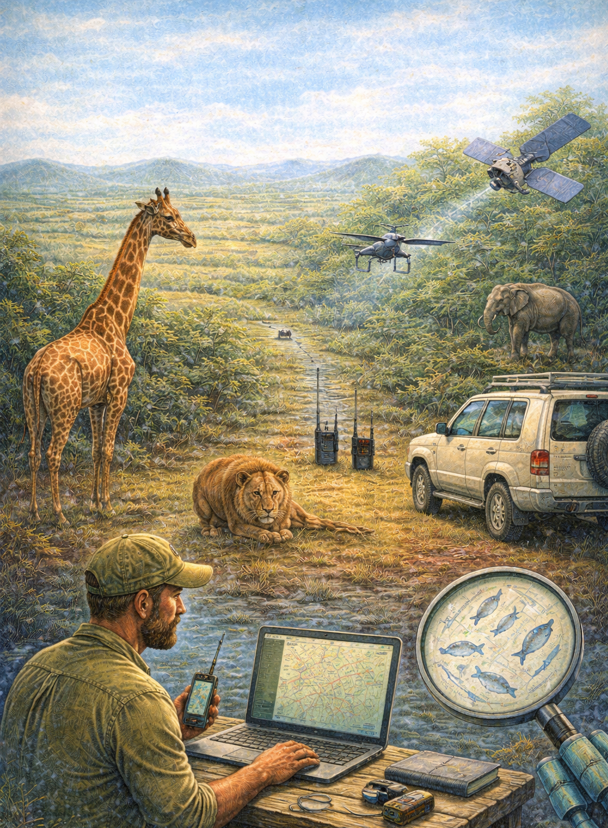
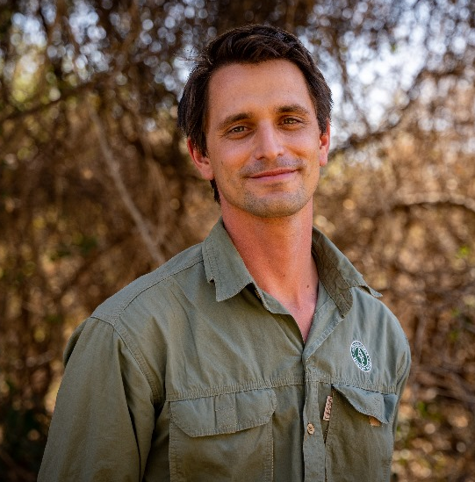
Protected area management in Central Africa and technological solutions
– my experiences as a former CZU student
(Scientific Seminar of the DWAS, FTZ, CZU)
Mathias D’Haen
partnership manager,
EarthRanger
When:
March 19th, 2026
14:00-15:30
Where:
FTZ, room 116
Studying Kordofan Giraffe in Garamba National Park in the DR Congo through my master programme at the CZU, I was able to kickstart my career in central Africa. I was later employed by African Parks who manages 22 protected areas in Africa and through which I travelled and worked in many places in Central Africa (Chinko (CAR), Odzala (Rep. Congo), Zakouma, Siniaka Minia, Aouk and Ennedi (Chad), Pendjari and W (Benin) and Boma and Badingilo (South Sudan). For a period of 9 years, I was working on a variety of technology solu-tions in these environments, and recently started working for EarthRanger, a software platform for conservationists and protected area managers to monitor field work in real time.

